Slide 1
Module 5: Number Systems
Introduction to Networks v7.0 (ITN)
Notes:
Cisco Networking Academy Program
Introduction to Networks v7.0 (ITN)
Module 5: Number Systems

Slide 2
Module Objectives
Module Title: Number Systems
Module Objective: Calculate numbers between decimal, binary, and hexadecimal systems.
Topic Title | Topic Objective
Binary Number System | Calculate numbers between decimal and binary systems.
Hexadecimal Number System | Calculate numbers between decimal and hexadecimal systems.
Notes:
2
5.0- Introduction
5.0.2 – What will I learn in this module?

Slide 3
5.1 Binary Number System
Notes:
5 -Number Systems
5.1 Binary Number System

Slide 4
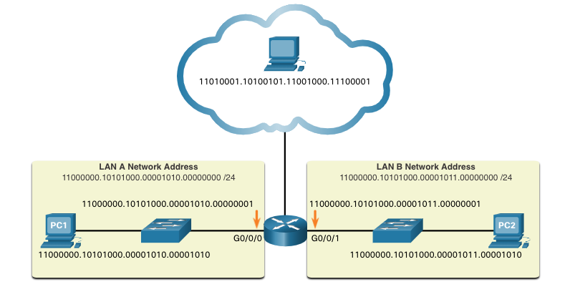
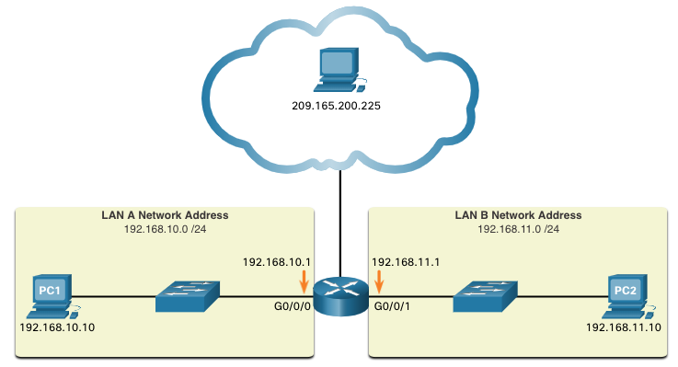
Binary Number System Binary and IPv4 Addresses
Binary numbering system consists of 1s and 0s, called bits
Decimal numbering system consists of digits 0 through 9
Hosts, servers, and network equipment using binary addressing to identify each other.
Each address is made up of a string of 32 bits, divided into four sections called octets.
Each octet contains 8 bits (or 1 byte) separated by a dot.
For ease of use by people, this dotted notation is converted to dotted decimal.
Notes:
5 – Number Systems
5.1 – Binary Number Systems
5.1.1 – Binary and IPv4 Addresses

Slide 5
Binary Number System Video – Convert Between Binary and Decimal Numbering Systems
This video will cover the following:
Positional notation review
Powers of 10 review
Decimal – base 10 numbering review
Binary – base 2 numbering review
Convert an P address in binary to decimal numbering
Notes:
5 – Number Systems
5.1 – Binary Number Systems
5.1.2 – Video – Convert Between Binary and Decimal Numbering Systems

Slide 6
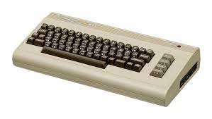
Decimal Notation
10³ 10² 10¹ 10⁰.
1000 100 10 1 .
Decimal Point / Radix Point
5432₁₀ = 5x1000 + 4x100 + 3x10 + 2x1
Binary Notation
2¹⁵ … 2¹⁰ 2⁹ 2⁸ 2⁷ 2⁶ 2⁵ 2⁴ 2³ 2² 2¹ 2⁰.
65536 … 1024 512 256 128 64 32 16 8 4 2 1 .
Binary Point / Radix Point
2¹⁰ = 1024 = 1K, 2¹⁵ = 65,536 = 64K
The Commodore 64 had 64K memory!
132₁₀ = 1x128 + 0x64 + 0x32 + 0x16 + 0x8 + 1x4 + 0x2 + 0x1 or 10000100.₂

Slide 7
Decimal Base 10 to Binary Base 2 Number Conversion!
Problem: 177₁₀ to Binary
Method 1: Double Dabble
2 177
88 Remainder 1
2 44 Remainder 0
22 Remainder 0
2 11 Remainder 0
5 Remainder 1
2 2 Remainder 1
1 Remainder 0
0 Remainder 1 10110001.₂
Method 2: Subtraction
Powers of 2
2⁷ 2⁶ 2⁵ 2⁴ 2³ 2² 2¹ 2⁰.
128 64 32 16 8 4 2 1 .
177 1 0 1 1 0 0 0 1 .
-128
49
- 32
17
- 16
1
1
0
Can’t Subtract 64
Can’t Subtract 8, 4, or 2
Eight (8) Steps!
Four (4) Steps!

Slide 8
Binary Number System Binary Positional Notation
Positional notation means that a digit represents different values depending on the “position” the digit occupies in the sequence of numbers.
The decimal positional notation system operates as shown in the tables below.
 | Thousands | Hundreds | Tens | Ones
Positional Value | 1000 | 100 | 10 | 1
Decimal Number (1234) | 1 | 2 | 3 | 4
Calculate | 1 x 1000 | 2 x 100 | 3 x 10 | 4 x 1
Add them up… | 1000 | + 200 | + 30 | + 4
Result | 1,234
Radix | 10 | 10 | 10 | 10
Position in Number | 3 | 2 | 1 | 0
Calculate | (10³) | (10²) | (10¹) | (10⁰)
Position Value | 1000 | 100 | 10 | 1
Notes:
5 – Number Systems
5.1 – Binary Number Systems
5.1.3 – Binary Positional Notation

Slide 9
Binary Number System Binary Positional Notation (Cont.)
The binary positional notation system operates as shown in the tables below.
Radix | 2 | 2 | 2 | 2 | 2 | 2 | 2 | 2
Position in Number | 7 | 6 | 5 | 4 | 3 | 2 | 1 | 0
Calculate | (2⁷) | (2⁶) | (2⁵) | (2⁴) | (2³) | (2²) | (2¹) | (2⁰)
Position Value | 128 | 64 | 32 | 16 | 8 | 4 | 2 | 1
Positional Value | 128 | 64 | 32 | 16 | 8 | 4 | 2 | 1
Binary Number (11000000) | 1 | 1 | 0 | 0 | 0 | 0 | 0 | 0
Calculate | 1x128 | 1x64 | 0x32 | 0x16 | 0x8 | 0x4 | 0x2 | 0x1
Add Them Up… | 128 | + 64 | + 0 | + 0 | + 0 | + 0 | + 0 | + 0
Result | 192
Notes:
5 – Number Systems
5.1 – Binary Number Systems
5.1.3 – Binary Positional Notation
5.1.4 – Check Your Understanding – Binary Number System

Slide 10
Binary Number System Convert Binary to Decimal
Convert 11000000.10101000.00001011.00001010 to decimal.
Positional Value | 128 | 64 | 32 | 16 | 8 | 4 | 2 | 1
Binary Number (11000000) | 1 | 1 | 0 | 0 | 0 | 0 | 0 | 0
Calculate | 1x128 | 1x64 | 0x32 | 0x16 | 0x8 | 0x4 | 0x2 | 0x1
Add Them Up… | 128 | + 64 | + 0 | + 0 | + 0 | + 0 | + 0 | + 0
Binary Number (10101000) | 1 | 0 | 1 | 0 | 1 | 0 | 0 | 0
Calculate | 1x128 | 0x64 | 1x32 | 0x16 | 1x8 | 0x4 | 0x2 | 0x1
Add Them Up… | 128 | + 0 | + 32 | + 0 | + 8 | + 0 | + 0 | + 0
Binary Number (00001011) | 0 | 0 | 0 | 0 | 1 | 0 | 1 | 1
Calculate | 0x128 | 0x64 | 0x32 | 0x16 | 1x8 | 0x4 | 1x2 | 1x1
Add Them Up… | 0 | + 0 | + 0 | + 0 | + 8 | + 0 | + 2 | + 1
Binary Number (00001010) | 0 | 0 | 0 | 0 | 1 | 0 | 1 | 0
Calculate | 0x128 | 0x64 | 0x32 | 0x16 | 1x8 | 0x4 | 1x2 | 0x1
Add Them Up… | 0 | + 0 | + 0 | + 0 | + 8 | + 0 | + 2 | + 0
192
168
192.168.11.10
11
10
Notes:
5 – Number Systems
5.1 – Binary Number Systems
5.1.5 - Convert Binary to Decimal
5.1.6 – Activity – Binary to Decimal Conversions

Slide 11
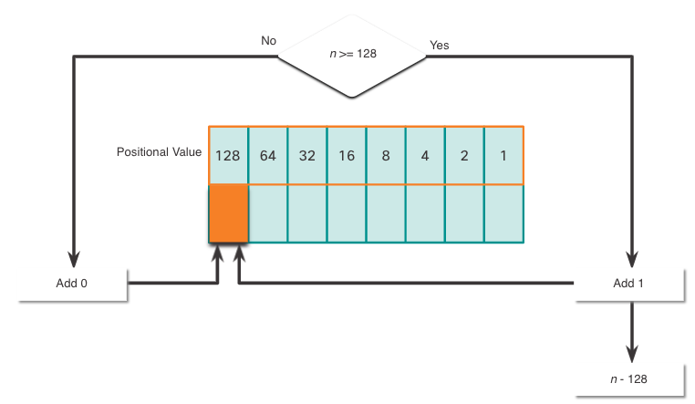
Binary Number System Decimal to Binary Conversion
The binary positional value table is useful in converting a dotted decimal IPv4 address to binary.
Start in the 128 position (the most significant bit). Is the decimal number of the octet (n) equal to or greater than 128?
If no, record a binary 0 in the 128 positional value and move to the 64 positional value.
If yes, record a binary 1 in the 128 positional value, subtract 128 from the decimal number, and move to the 64 positional value.
Repeat these steps through the 1 positional value.
Notes:
5 – Number Systems
5.1 – Binary Number Systems
5.1.7 – Decimal to Binary Conversion

Slide 12
Binary Number System Decimal to Binary Conversion Example
Convert decimal 168 to binary
Is 168 > 128?
Yes, enter 1 in 128 position and subtract 128 (168-128=40)
Is 40 > 64?
No, enter 0 in 64 position and move on
Is 40 > 32?
Yes, enter 1 in 32 position and subtract 32 (40-32=8)
Is 8 > 16?
No, enter 0 in 16 position and move on
Is 8 > 8?
Equal. Enter 1 in 8 position and subtract 8 (8-8=0)
No values left. Enter 0 in remaining binary positions
128 | 64 | 32 | 16 | 8 | 4 | 2 | 1
1 | 0 | 1 | 0 | 1 | 0 | 0 | 0
Decimal 168 is written as 10101000 in binary
Notes:
5 – Number Systems
5.1 – Binary Number Systems
5.1.8 – Decimal to Binary Conversion Example
5.1.9 - Activity – Decimal to Binary Conversions
5.1.10 – Activity – Binary Game

Slide 13
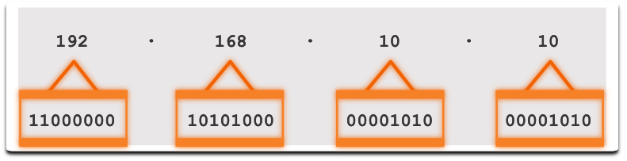
Binary Number System IPv4 Addresses
Routers and computers only understand binary, while humans work in decimal. It is important for you to gain a thorough understanding of these two numbering systems and how they are used in networking.
Notes:
5 – Number Systems
5.1 – Binary Number Systems
5.1.11 – IPv4 Addresses

Slide 14
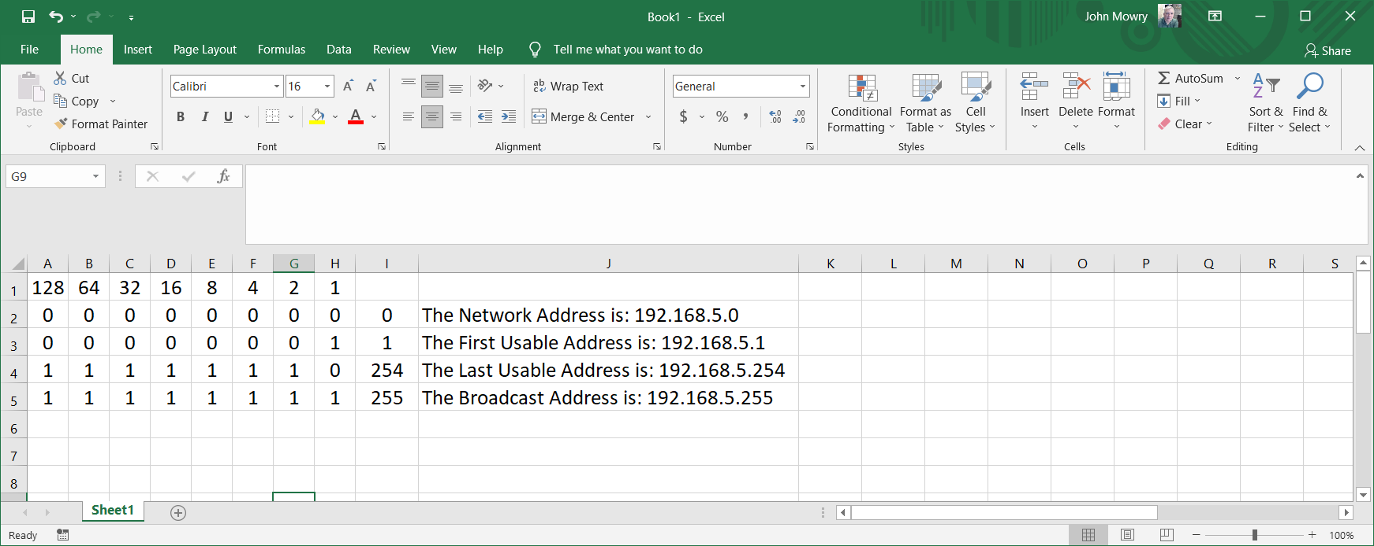
Using Excel to convert Binary to Decimal
Cell I2 Formula: =sum(A2*128+B2*64+C2*32+D2*16+E2*8+F2*4+G2*2+H2)
To insert value of I2 into a sentence: =“The Network Address is: 192.168.5.”&I2

Slide 15
5.2 Hexadecimal Number System
Notes:
5- Number Systems
5.2 - Hexadecimal Number System

Slide 16
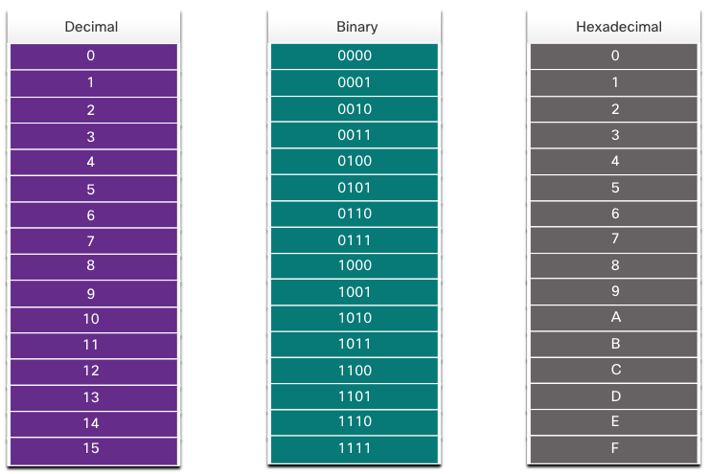
Hexadecimal Number System Hexadecimal and IPv6 Addresses
To understand IPv6 addresses, you must be able to convert hexadecimal to decimal and vice versa.
Hexadecimal is a base sixteen numbering system, using the digits 0 through 9 and letters A to F.
It is easier to express a value as a single hexadecimal digit than as four binary bit.
Hexadecimal is used to represent IPv6 addresses and MAC addresses.
Notes:
5 – Number Systems
5.2 – Hexadecimal Number Systems
5.2.1– Hexadecimal and IPv6 Addresses

Slide 17
Creating an Hexadecimal Chart
Start Here at the MSD!

Slide 18
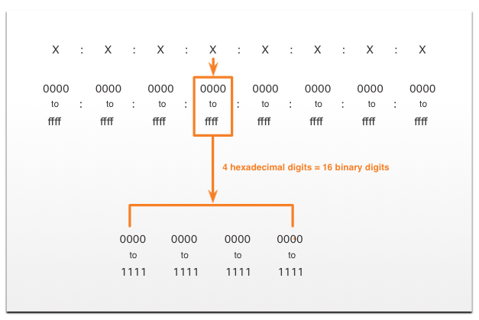
Hexadecimal Number System Hexadecimal and IPv6 Addresses (Cont.)
IPv6 addresses are 128 bits in length. Every 4 bits is represented by a single hexadecimal digit. That makes the IPv6 address a total of 32 hexadecimal values.
The figure shows the preferred method of writing out an IPv6 address, with each X representing four hexadecimal values.
Each four hexadecimal character group is referred to as a hextet.
Notes:
5 – Number Systems
5.2 – Hexadecimal Number Systems
5.2.1– Hexadecimal and IPv6 Addresses

Slide 19
Hexadecimal Number System Video – Converting Between Hexadecimal and Decimal Numbering Systems
This video will cover the following:
Characteristics of the Hexadecimal System
Convert from Hexadecimal to Decimal
Convert from Decimal to Hexadecimal
Notes:
5 – Number Systems
5.2 – Hexadecimal Number Systems
5.2.2 – Video – Converting Between Hexadecimal and Decimal Numbering Systems

Slide 20
Hexadecimal Number System Decimal to Hexadecimal Conversions
Follow the steps listed to convert decimal numbers to hexadecimal values:
Convert the decimal number to 8-bit binary strings.
Divide the binary strings in groups of four starting from the rightmost position.
Convert each four binary numbers into their equivalent hexadecimal digit.
For example, 168 converted into hex using the three-step process.
168 in binary is 10101000.
10101000 in two groups of four binary digits is 1010 and 1000.
1010 is hex A and 1000 is hex 8, so 168 is A8 in hexadecimal.
Notes:
5 – Number Systems
5.2 – Hexadecimal Number Systems
5.2.3 – Decimal to Hexadecimal Conversions

Slide 21
Hexadecimal Number System Hexadecimal to Decimal Conversions
Follow the steps listed to convert hexadecimal numbers to decimal values:
Convert the hexadecimal number to 4-bit binary strings.
Create 8-bit binary grouping starting from the rightmost position.
Convert each 8-bit binary grouping into their equivalent decimal digit.
For example, D2 converted into decimal using the three-step process:
D2 in 4-bit binary strings is 1101 and 0010.
1101 and 0010 is 11010010 in an 8-bit grouping.
11010010 in binary is equivalent to 210 in decimal, so D2 is 210 is decimal
Notes:
5 – Number Systems
5.2 – Hexadecimal Number Systems
5.2.4 - Hexadecimal to Decimal Conversions
5.2.5 – Check Your Understanding – Hexadecimal Number System

Slide 22
Decimal Notation
10³ 10² 10¹ 10⁰.
1000 100 10 1 .
Decimal Point / Radix Point
5432₁₀ = 5x1000 + 4x100 + 3x10 + 2x1
Hexadecimal Notation
16³ 16² 16¹ 16⁰.
4096 256 16 1 .
Hexadecimal Point / Radix Point
5432₁₀ = 1538₁₆
4096 5432
1
Remainder 1336
256 1336
5
Remainder 56
16 56
3
Remainder
8
1 8
8
Remainder
0

Slide 23
Binary, Decimal, Hexadecimal Conversion
4096 2048 1024 512 256 128 64 32 16 8 4 2 1.
1 0 1 0 1 0 0 1 1 1 0 0 0.₂
5432₁₀ =
Note: If less than four (4) Binary digits, insert leading zero’s
0001
0101
0011
1000
1
5
3
8.₁₆
Conversion Results
5432₁₀ = 1010100111000₂ = 1538₁₆

Slide 24
5.3 Module Practice and Quiz
Notes:
5 - Number Systems
5.3 Module Practice and Quiz

Slide 25
Module Practice and Quiz What did I learn in this module?
Binary is a base two numbering system that consists of the numbers 0 and 1, called bits.
Decimal is a base ten numbering system that consists of the numbers 0 through 9.
Binary is what hosts, servers, and networking equipment uses to identify each other.
Hexadecimal is a base sixteen numbering system that consists of the numbers 0 through 9 and the letters A to F.
Hexadecimal is used to represent IPv6 addresses and MAC addresses.
IPv6 addresses are 128 bits long, and every 4 bits is represented by a hexadecimal digit for a total of 32 hexadecimal digits.
To convert hexadecimal to decimal, you must first convert the hexadecimal to binary, then convert the binary to decimal.
To convert decimal to hexadecimal, you must first convert the decimal to binary and then the binary to hexadecimal.
Notes:
5 – Number Systems
5.3 - Module Practice and Quiz
5.3.1 – What Did I Learn In This Module?
5.3.2 – Module Quiz

Slide 26
Module 5: Number Systems New Terms and Commands
dotted decimal notation
positional notation
base 10
base 16
radix
octet
hextet

